Slide 1


12th–19th February 2025
INTRODUCTION TO TEXT
ANALYSIS WITH PYTHON
Instructor: Xandra Dave Cochran
www.cdcs.ed.ac.uk

Slide 2


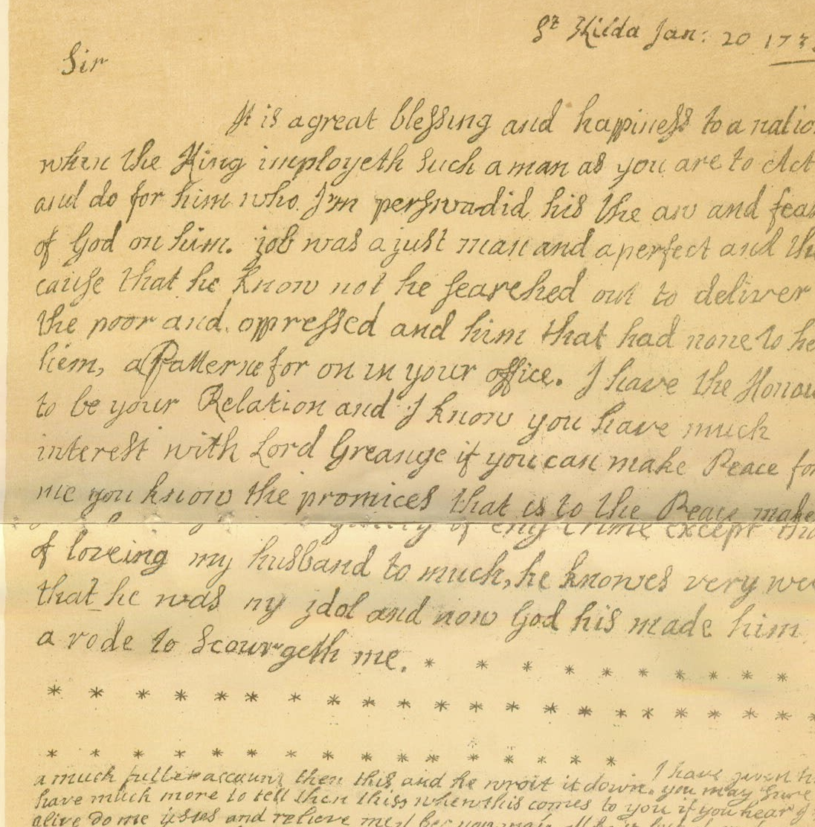
Week 2 Topics
Corpus Research with NLTK
Data Visualisation
Regular Expressions
Data Cleaning
www.cdcs.ed.ac.uk

Slide 3
Assignment
How’s it going?
Any questions?
www.cdcs.ed.ac.uk

Slide 4
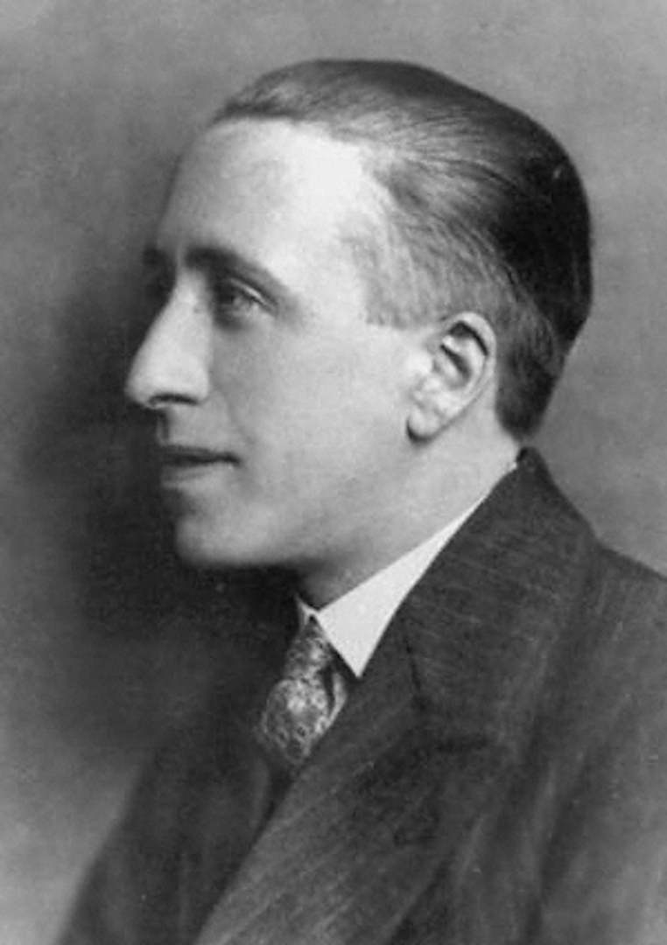
Research with NLTK
Corpus: Lewis Grassic Gibbon First Editions (National Library of Scotland)
Questions:
What are the most common words in the corpus?
What are the most common words in one book from the corpus?
How does the word choice of the author change from one book to another?
Lexical diversity = count of unique words / count of all words
www.cdcs.ed.ac.uk

Slide 5
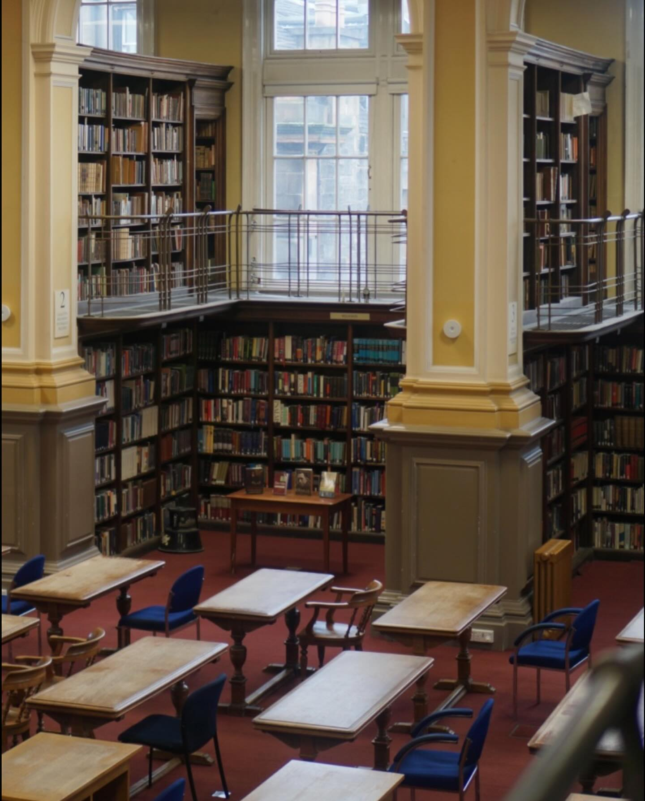
Finding Text Sources
Libraries - NLS Data Foundry (data.nls.uk)
Project Gutenberg (gutenberg.org)
Hathi Trust Digital Library (hathitrust.org)
Websites - Internet Archive (archive.org)'s Wayback Machine, UK Web
archive (webarchive.org.uk)
Newspaper archives (universities often subscribe to them!)
www.cdcs.ed.ac.uk

Slide 6


Slide 7
Let’s Code!

Slide 8
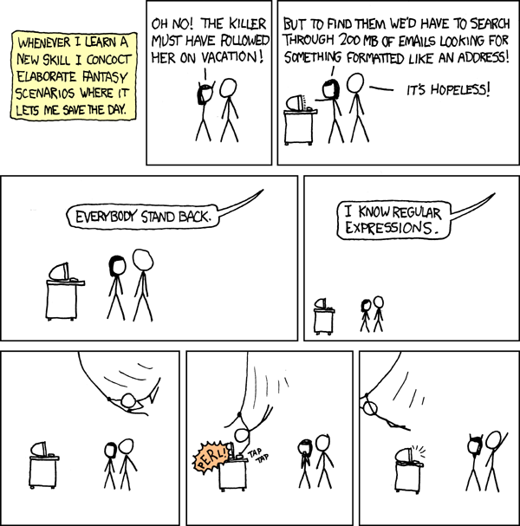
Regular Expressions (RegEx)
Pattern matching for the string (str) data type
Documentation:
Intro:
https://docs.python.org/3/howto/regex.html#regex-howto
Python re module:
https://docs.python.org/3/library/re.html
For practice:
https://regex101.com/
http://pythex.org/
Check out the Pythex cheat sheet!
www.cdcs.ed.ac.uk

Slide 9
Regular Expressions (RegEx)
To use in a Jupyter Notebook:
import re
To find patterns (2 ways):
re.findall("regex_pattern", "string_to_search")
["list", "of", "all", "matches", "found"]
p = re.compile("regex_pattern")
p.findall("string_to_search")
["list", "of", "all", "matches", "found"]
www.cdcs.ed.ac.uk

Slide 10
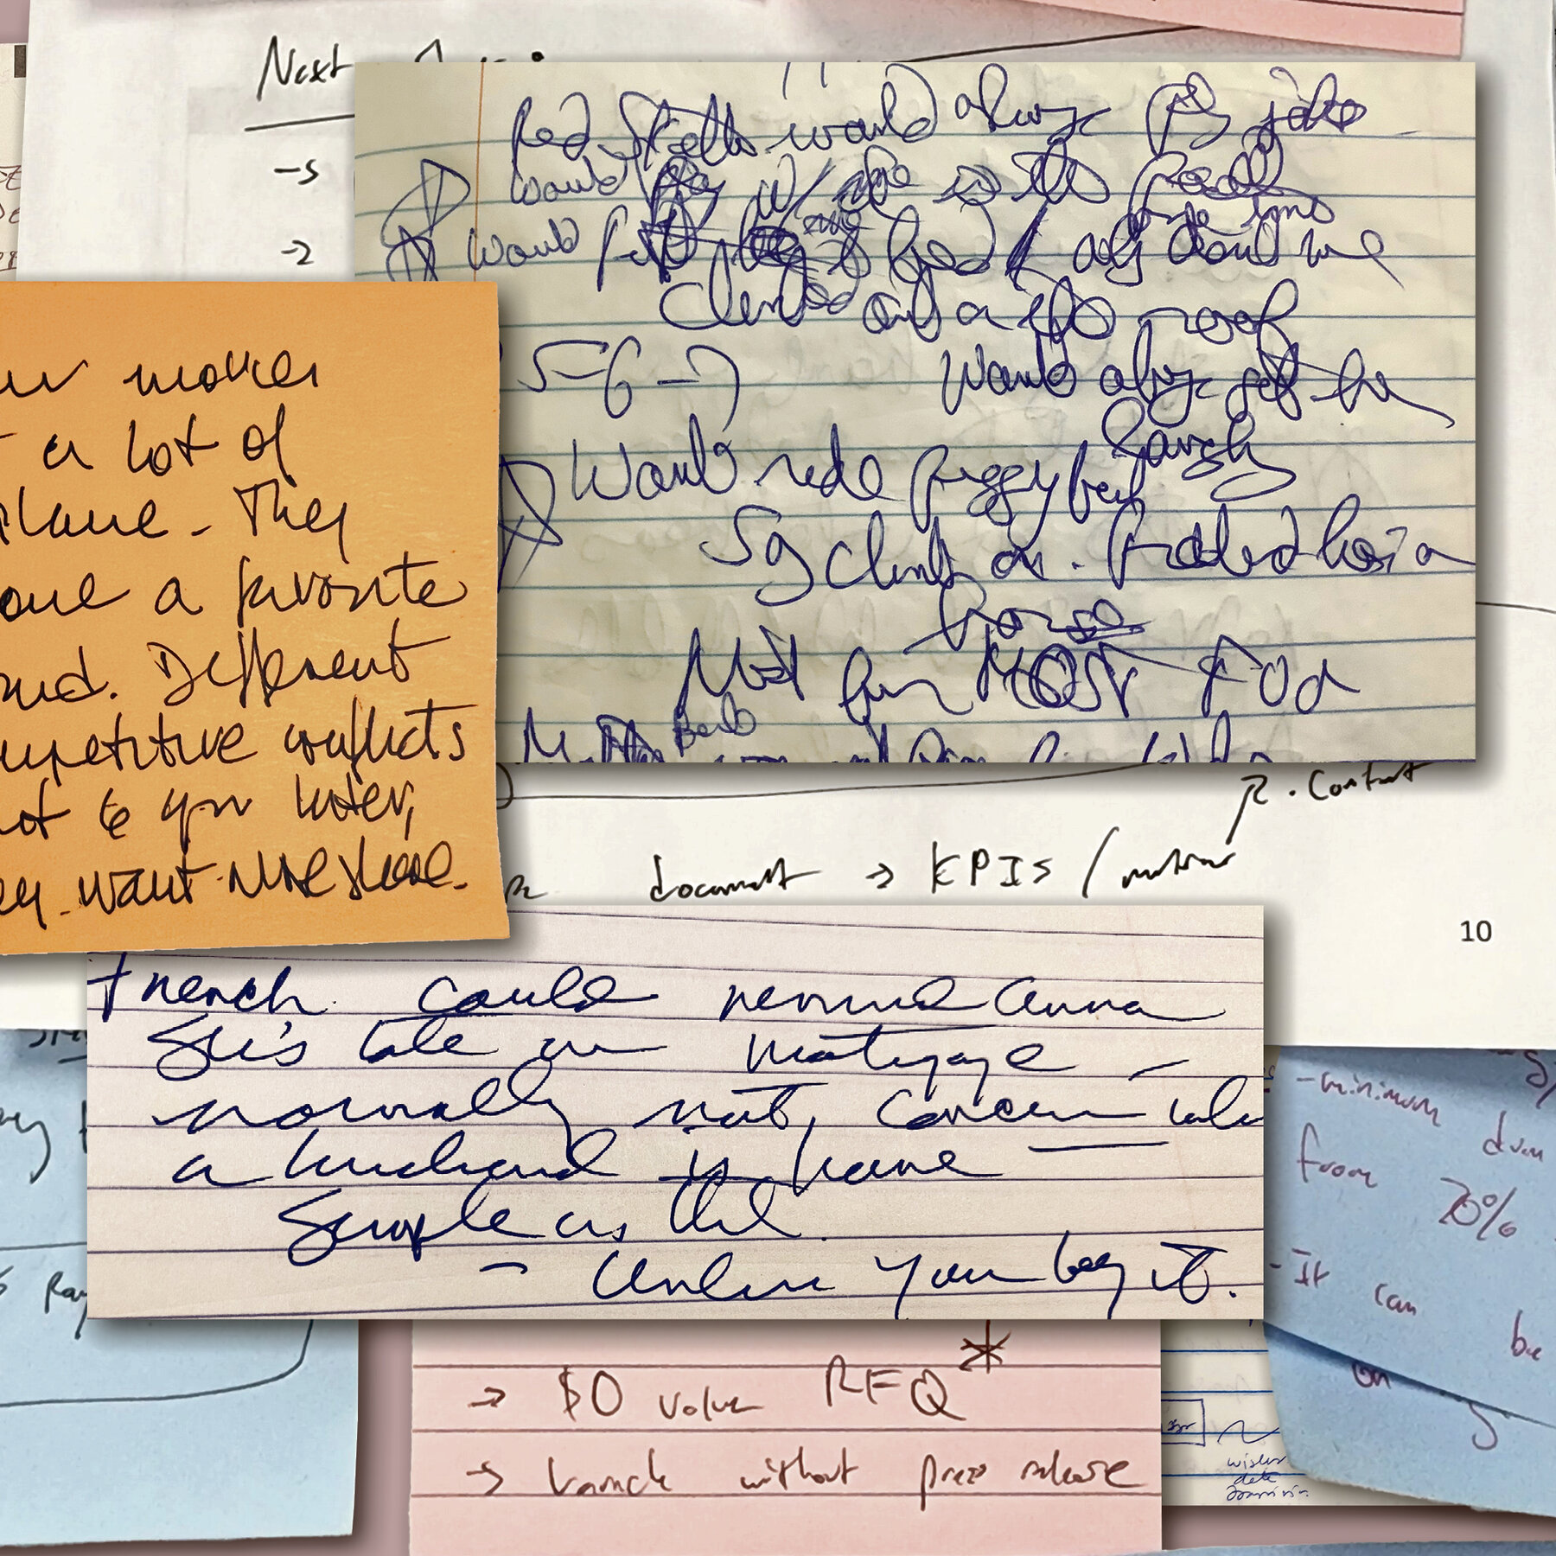
Cleaning Messy Text
Remember, digitization is imperfect
• Includes OCR (optical character recognition)
• Includes HWT or HRT (handwriting recognition)
Besides Regular Expressions, you can use…
s.strip() - remove leading & trailing whitespace or input characters in string s
s.replace(‘a’, ‘b’) - replace a with b in string s
www.cdcs.ed.ac.uk

Slide 11

Beware!
Be careful not to spend all your time cleaning data! It may be useful to time-box this task so that you do not run out of time for the actual analysis work.
Alternatively, you could consider investing in or applying for funds to manually correct your text. This will yield more accurate results than programmatic methods.
www.cdcs.ed.ac.uk

Slide 12
Let’s Code!

Slide 13
Text Analysis: NLTK & Beyond
Training Pathway for Text Analysis
https://www.cdcs.ed.ac.uk/training/training-pathways/text-analysis-pathway
Sentiment Analysis Tutorial in Jupyter Notebooks
Includes cleaning up text! Uses an NLTK tool called VADER for sentiment analysis
https://github.com/DCS-training/SentimentAnalysistimes
Text Analysis with Constellate
Uses Jupyter Notebooks and libraries other than NLTK
https://github.com/ithaka/constellate-notebooks
Topic Modelling with BERT
Uses Jupyter Notebooks and BERT, a transformer-based LLM. Will be delivered by me on 28th Feb–7th Mar this semester
https://www.cdcs.ed.ac.uk/events/intro-topic-modelling-feb25
W3Schools - Python, RegEx, and much more!
https://www.w3schools.com/
www.cdcs.ed.ac.uk

Slide 14
Thanks Everyone
Please message me on Teams for office hours!

Slide 15
Beware!
Be careful not to spend all your time cleaning data! It may be useful to time-box this task so that you do not run out of time for the actual analysis work.
Alternatively, you could consider investing in or applying for funds to manually correct your text. This will yield more accurate results than programmatic methods.

Slide 16

Text Analysis with NLTK: 2

